Slide 1
Soil analysis using machine learning
By: Mahmood Yousaf
Supervisor: Dr Malik Jahan Khan

Slide 2
Agenda
Problem statement
Proposed solution
Dataset
Methodology
Results
Future plan
Questions

Slide 3




Problem Statement
Time consuming
Soil sample
Laboratory Testing
More Cost
Soil analysis using machine learning

Slide 4

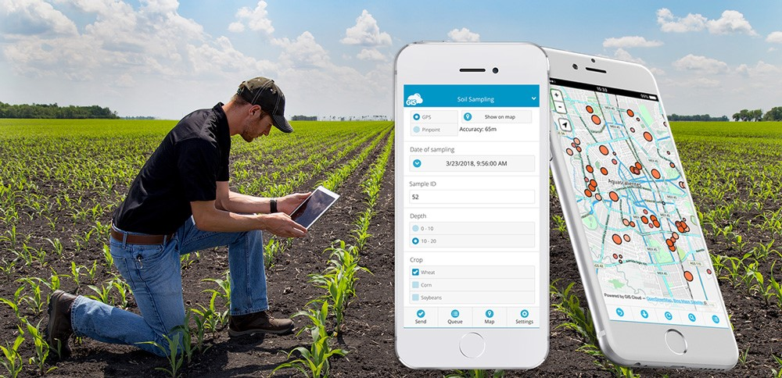

Solution
Provide Report
Fertilizer recommendations
Mobile Application
Soil Sampling
AI models
Soil analysis using machine learning

Slide 5
Literature review
In the year 2014 , the author Vinay Kumar determined soil PH values by using digital image processing technique. In this work fifty soil samples were collected and determined their PH values using PH meter. Digital camera was used for sampling the soil images. By using below formula, PH index is calculated.
PH Index = ( Red / Green ) / Blue
In the year 2016 , the author CS ManikandaBabu determined physical and chemical properties of soil by using digital image analysis. For soil sampling, digital camera was used. They used fractal dimension calculation using box counting method to obtain physical recognition. They determined soil PH by using RGB colors. By using plane extraction method, each plane value is calculated and PH index is calculated. By using PH index and color of soil, PH of soil sample was calculated.
In the year 2019, the author Maneesha G Nair proposed android application which was capable to use digital image processing. By capturing image of soil, soil PH value was determined and crop suggestion as output. After prepossessing, ,RGB values are extracted from image to calculate PH index. PH index value was compared with stored PH value in databased.
1/27/2022

Slide 6
Dataset
Dataset is collected by mobile phone camera
Locations are Mianwali, Talagang and Khusab
There are about 4000 soil samples with images
Available ground truth is 1064 soil samples with EC, P, pH and P values
Testing in soil laboratory is in progress
1/27/2022

Slide 7
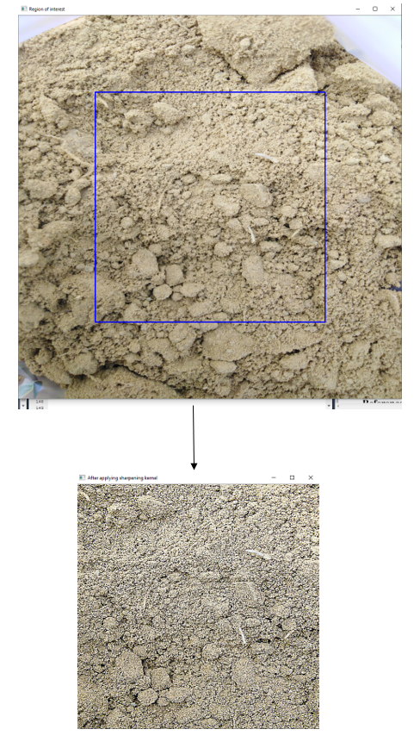
Preprocessing
Image resizing using OpenCV
Extracted ROI
Applying sharpening kernel
Sharpening kernel for dealing with blur effect and some lightening issues
Fig: Extracting ROI and applying sharpening kernel
1/27/2022

Slide 8
Features Extraction
Calculation of pH Indexes
pH Index = (Red / Green) / Blue
Calculation using experimentation based formula
Formula = Red + Green + Blue
1/27/2022

Slide 9
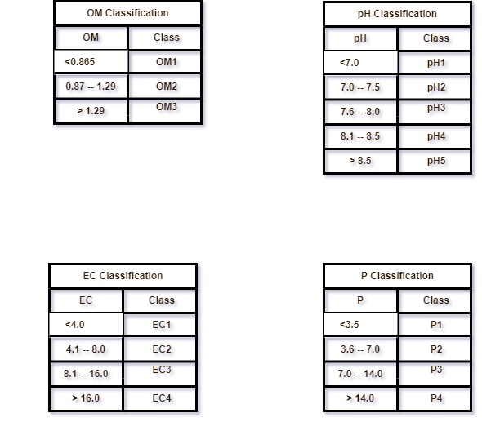
Discretization
By using soil laboratory manual
1/27/2022

Slide 10
Methodology
Artificial neural networks (ANN) models (8)
Support Vector Regression (SVR) models (8)
Decision Tree Regression (DTR) models (8)
Random Forest Regression (RFR) models (8)
Convolution neural network (CNN) regression models (4)
Convolution neural network (CNN) classification models (4)
Total models are 40
Each model is trained for each parameter separately
1/27/2022

Slide 11
Areas of growth
 | B2B | Supply chain | ROI | E-commerce
Q1 | 4.5 | 2.3 | 1.7 | 5.0
Q2 | 3.2 | 5.1 | 4.4 | 3.0
Q3 | 2.1 | 1.7 | 2.5 | 2.8
Q4 | 4.5 | 2.2 | 1.7 | 7.0

Slide 12
Business opportunities are like buses. There's always another one coming.
“
”
Richard Branson

Slide 13




Meet our team
Takuma Hayashi
Mirjam Nilsson
President
Chief Executive Officer
Flora Berggren
Rajesh Santoshi
Chief Operation Officer
VP Marketing

Slide 14







The full team
Takuma Hayashi
Mirjam Nilsson
Flora Berggren
Rajesh Santoshi
President
Chief Executive Officer
Chief Operations Manager
VP Marketing
Graham Barnes
Rowan Murphy
Elizabeth Moore
Robin Kline
VP Product
SEO Strategist
Product Designer
Content Developer

Slide 15
Plan for product launch
Deploy strategic networks with compelling e-business needs
Planning
Synergize scalable e-commerce
Marketing
Disseminate standardized metrics
Design
Coordinate
Foster holistically superior methodologies
Launch
Strategy
e-business applications
1
2
3
4
5

Slide 16
Timeline
Deploy strategic networks with compelling e-business needs
Sep 20XX
Synergize scalable e-commerce
Nov 20XX
Disseminate standardized metrics
Jan 20XX
Coordinate e-business applications
March 20XX
Foster holistically superior methodologies
May 20XX

Slide 17
Areas of focus
B2B market scenarios
Cloud-based opportunities
Develop winning strategies to keep ahead of the competition
Capitalize on low-hanging fruit to identify a ballpark value
Visualize customer directed convergence
Iterative approaches to corporate strategy
Establish a management framework from the inside

Slide 18
How we get there
ROI
Niche Markets
Supply chains
Envision multimedia-based expertise and cross-media growth strategies
Visualize quality intellectual capital
Engage worldwide methodologies with web-enabled technologies
Pursue scalable customer service through sustainable strategies
Engage top-line web services with cutting-edge deliverables
Cultivate one-to-one customer service with robust ideas
Maximize timely deliverables for real-time schemas

Slide 19
Summary
At Contoso, we believe in giving 110%. By using our next-generation data architecture, we help organizations virtually manage agile workflows. We thrive because of our market knowledge and great team behind our product. As our CEO says, "Efficiencies will come from proactively transforming how we do business."

Slide 20
Thank you
Mirjam Nilsson​
mirjam@contoso.com
www.contoso.com

Slide 21
References
2022 Cost of Soil Testing | Price of Soil Quality Testing and Analysis – HomeAdvisor
Soil sampling using mobile - Google Search
Vinay Kumar, B. K. Vimal, Rakesh Kumar, and Mukesh Kumar. Determination of soil ph by using digital image processing technique. Journal of Applied and Natural Science, 6:14–18, 2014.
CS ManikandaBabu and M Arun Pandian. Determination of physical and chemical characteristics of soil using digital image processing. DIGITAL IMAGE PROCESSING, 1:2, 2016.
AV Guilalas, M Devoor, M Mizoguchi International Journal of . . . , and 2019. Determination of soil ph using digital image processing. 2019

